Slide 1
How to read a research paper

Slide 2
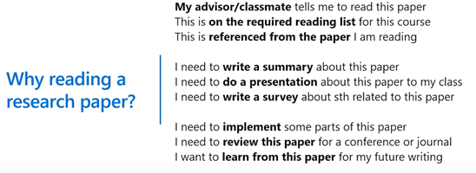
DR. xiangyang Shen： presentation at GIX
Notes:
文中部分slides来自沈向洋博士在全球创新学院（GIX）课程上一场线上公开课《You are how you read》

Slide 3
Why is reading research papers so hard?
Hard to read
  Many papers are badly written
Difficult to understand
    Lack of background for the topics
  Easy to get stuck
    Where to get help? ask someone?
  What to read next:
    Beyond what my advisor tells me
  Impossible to focus:
    How to read long-form at internet time

Slide 4
Jonathan Shewchuck
sucking a camel through the eye of the proverbial needle
http://www.cs.cmu.edu/~jrs/sins.html

Slide 5
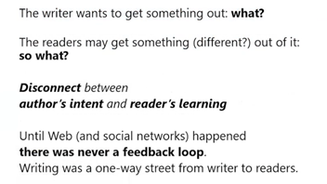
The disconnect between reading and writing

Slide 6
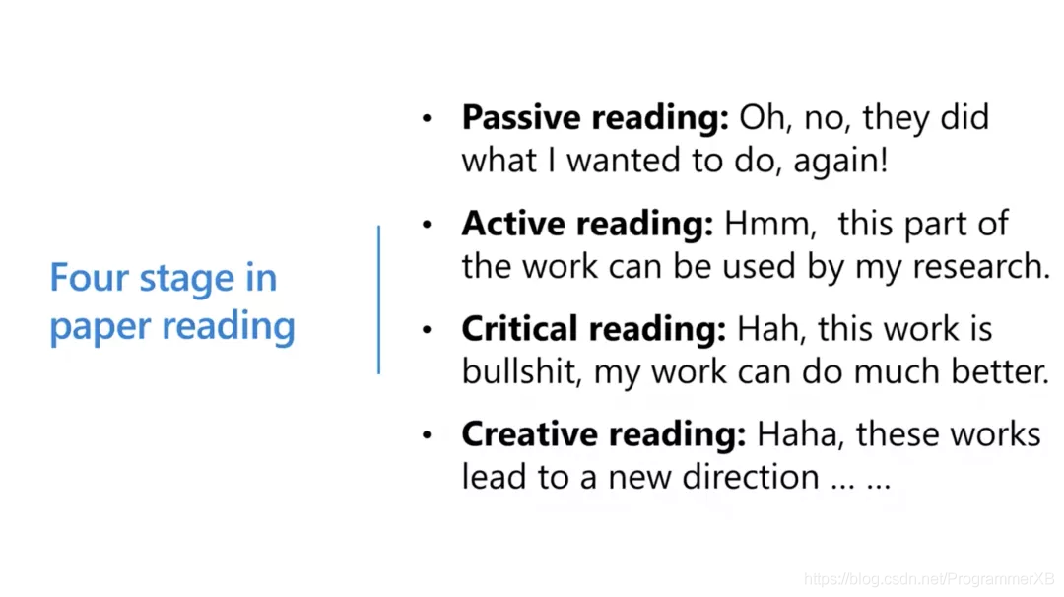
Four stage in paper reading
https://blog.csdn.net/ProgrammerXB/article/details/107560397

Slide 7
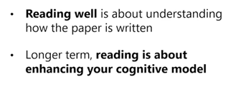
How do you approach reading papers?
Quick skimming
  Figure browsing
Critical reading
  Creative reading
Deep Analyzing
Notes:
对于快速阅读，一个小的技巧是图文浏览。因为一些好的论文必然是图文并茂，所以只要弄清楚论文中表格和图片的标题和注释，就能够获得这篇论文八、九成的信息。对于仔细阅读，你的心态必须是批判和创造的。精读一篇论文，首先要对论文进行否定、质疑，仔细挑毛病；其次，对论文有了足够的了解之后，如果发现论文中提到的想法非常优秀，那么要创造性地思考你能用这篇论文做什么。

Slide 8
Characteristics of Research Papers
Condensed Style
  Page Limits
  Target Audience: Researchers in Field
  Intended message ≠ Message you seek…
Reading as a novice
  Seek supplementary readings
  “Active Reading”
  Multiple, targeted readings

Slide 9
Types of Research Papers
Conference Papers
  Strict Page Limits (10-12 pages)
  Peer-reviewed (I.e., some quality control)
  Most visible venue for Systems Research
Journal Papers
  No (or very generous) page limits
  Peer-reviewed
  Expanded version of 1+ conference papers

Slide 10
Types of Research Papers (cont.)
Workshop Papers
  Strict Page Limits (10-12 pages)
  Peer-reviewed
  Designed to present early work (feedback-oriented)
Technical Reports
  Internal (Department) Publications
  No Page Limits
  Not peer-reviewed
  Best source of details

Slide 11
Active Reading
Questions to ask as you read…
  What are the motivations for this work?
  What is the proposed solution?
  What is the evaluation methodology?
  What are the contributions?

Slide 12
Active Reading
Multiple readings
  1st reading:
    Understand: motivation, contributions
    High-Level Understanding: solution, evaluation criteria
    Main Focuses: Introduction, Related Work, Conclusions
  2nd, 3rd readings:
    Deep understanding of solution, evaluation…

Slide 13
Active Reading
Deep Understanding of Solution
  If an algorithm: trace on examples
  If an architecture: trace execution
  “Paper-and-pencil” reading
Deep Understanding of Evaluation
  If a key proof: trace the steps of the proof
  If empirical: look for anomalies and explanations for them…

Slide 14
Paper type ( What they do)
Propose/formulate a new problem
Solve a problem people care about
Exposition and Survey

Slide 15
Quick Skimming
Shallow learning is important
Don Geman: a paper has four parts
  Title
  Abstract
  Introduction
  The rest of the paper
Readers cares more about the first two pages(maybe conclusion)
  Is this paper worth reading?
  Should I know something about this paper?
  Can this be quickly rejected(by conference)?

Slide 16
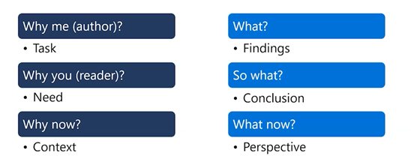
Structured layers of motivation/message
Notes:
总体上作者会思考：这篇论文的真实任务是什么、研究发现是什么；论文的贡献是什么等等。
读者在读论文的时候也应该要有逻辑，首先要清楚论文中的表达是否是我想要学习到的；其次，我能从论文中学到多少呢；最后，这篇论文的背景是什么——是什么样的背景让这篇论文变得重要和有趣。

Slide 17
Reading introduction
What your paper is about
What problem it solves
Why the problem is interesting
What is really new (and what isn’t)
Why it’s so neat

Slide 18
Owning ethics:Corporate Logics, Silicon Valley, and the institutionalization of Ethics
About: What high tech firms are doing with ethics
Problem: if current practice works
Interesting: latest scandals/attention and techlash
New: a study from interviewing 17 ethics owners
Neat:Ethics owners operate inside a frought dynamics
Industry logics: meritocracy, tech solutionism, market fundamentalism
Ethic pitfalls: normalizing ethical mishaps, blinkered isomorphism

Slide 19
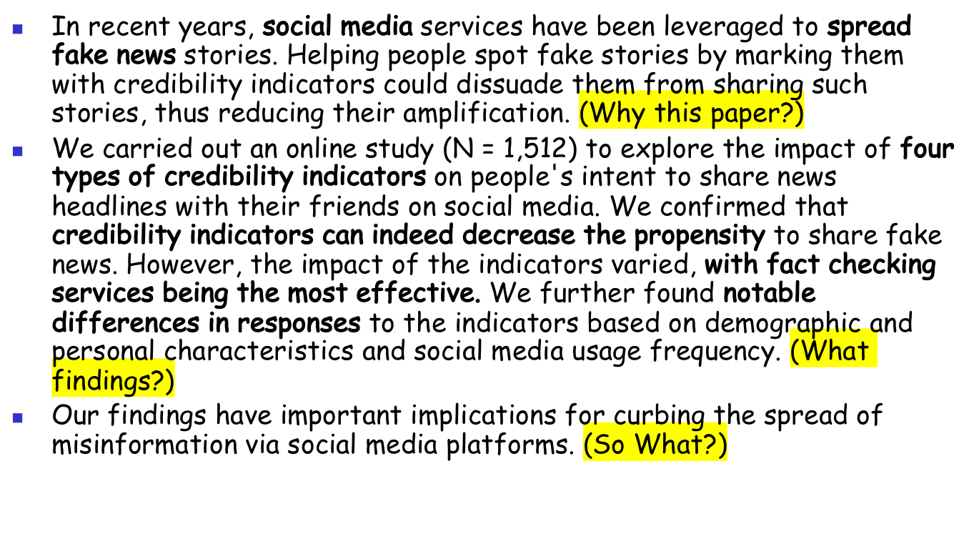
Effects of Credibility indicators on social media news sharing intent
Notes:
主要讲了社交媒体有可能传播假新闻，对这些媒体加上可信度标记可以减少人们分享假新闻倾向。了解文章的主题之后，然后你需要问自己这篇论文真正的发现是什么？通过继续阅读，你发现论文探究了四种可信度指标，每种可信度指标都能够减少人们分享的倾向，一些审查工作也能带来积极的效应，进一步发现，人口统计和个人特征以及社会特征会对可信度指标产生显著差异的影响。了解了这篇论文研究成果之后，接着问自己：我为什么要关注这个问题。接着读发现，原来这篇论文的研究成果对遏制虚假信息的传播有着重要的影响。考虑到目前美国信息传播的现状，这对节省研究员的学术精力非常重要，所以对于我来说，我应该关注这个问题。

Slide 20
Critical reading: ask questions, be suspicious
If the authors attempt to solve a problem
  Are they solving the right problem?
  Are there simple solutions not have considered?
  What are the limitations of the solution?
If the authors present data
  Do they have right data to substantiate argument?
  Do they gather it in the correct manner?
  Do they interpret data in a reasonable manner?
  Are there other more compelling data sets?
Are the authors’ assumptions reasonable?
  Is the logic clear & justifiable, given assumption?
  Is there a flaw in the reasoning?
Notes:
论文是否正确、真正地解决了问题？作者论文中所用方法是否有局限性？如果所读的论文没有解决问题，那么我能解决么？我能采用比论文中更简单的方法解决么？所以，一旦进入仔细阅读的状态，要在读论文之前对自己说：这篇论文可能有问题，我要找出来。
这时候你要问自己：在我所读的论文中，有哪些好的 idea？（一般文章中只有一个 idea，好的文章中可能有两个 idea，最了不起的文章可以有2.5个 idea。）搞清楚作者的 idea 以后你要思考，作者有哪些点还没有想到？可以怎么改进？如果我现在做这项研究，我能做的新事情是什么？

Slide 21
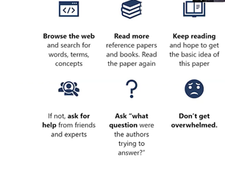
What do you do when you get stuck?
Copy from Dr. Xiangyan Shen
Notes:
批判性阅读可能非常难，也可能占用你很多的时间，你可能在读的过程中被卡住，但不要惊慌失措，要坚持下去！多找一些背景知识阅读，多做笔记，多在网上搜索相关论文，然后再次通读所卡壳的论文，并试着把它与其他论文相联系起来，如此坚持下去，定能渡过难关。

Slide 22
Creative reading: positive thinking
What are the good ideas in this paper?
Improvements that might make important practical differences?
Applications/extensions that the authors might not have thought of?
Can they be generalized further?
If you were going to start doing research from this paper, what next thing would you do?
http://www.eecs.Harvard.edu/~michaelm/postscripts/Readpaper.pdf
Notes:
好了，现在你已经知道了如何进行批判性的阅读，以及确信哪些论文值得读下去，甚至在读的过程中可能会产生一些好的想法。那么接下来要做一些改进，从而进入创造性阅读层面。这时候你要问自己：在我所读的论文中，作者有哪些点还没有想到？如果我现在做这项研究，我能做的新事情是什么？创造性的阅读需要把你所读的论文和其他相关的论文建立联系，从而产生一些新的想法，这些想法可以支撑你进行三个月到五个月的研究。如果你真正想理解你所读的论文，那么就写一个摘要吧，最好做一个口头展示，这样你会发现，只有把东西写下来或者说出来才能真正深刻理解。如果你能做一个报告，那就更好了，因为做报告的时候，别人可以问你问题，这会强迫你理解所读的论文。https://www.eecs.harvard.edu/~michaelm/postscripts/ReadPaper.pdf

Slide 23
Analyze with a list of questions
What’s main claim? Key idea?
What’s key limitation?
Is there code available? Data?
Is the idea neat? Is it counter-intuitive?
Is the contribution significant enough?
Is the experimentation good? Manual tuning?
Are there important related papers missed?
Is it useful to my work e.g. product dev?
Is this a paper worth following?
What do other people think about this paper?
Who are dominating this area of research?
What question should I ask the authors?
Notes:
图片的上半部分是比较客观的问题，包括论文的核心观点是什么？主要的局限性是什么？代码和数据是不是可得的？论文的贡献是否有意义？论文中的实验是否足够好？图片的下半部分是比较主观的问题，包括我错过了什么相关论文么？这对我的工作有何帮助么？这是一篇值得关注的论文么？这个研究领域的领头人是谁呢？其他的人对这篇论文有何看法呢？如果有机会见到作者，我应该问作者什么问题？

Slide 24
How to improve?
Write a summary, do a presentation about paper
Notes:
  Bib, summary, key points, figures, citations, structures, styles
Ask:
  People around you, more experienced researchers, the authors
Read more, keep reading
Be patient
  Reading=building your cognitive model!
Notes:
阅读的过程也是在你大脑中建立认知的过程。

Slide 25
DEMO
An conference paper
An Journal paper

Slide 26
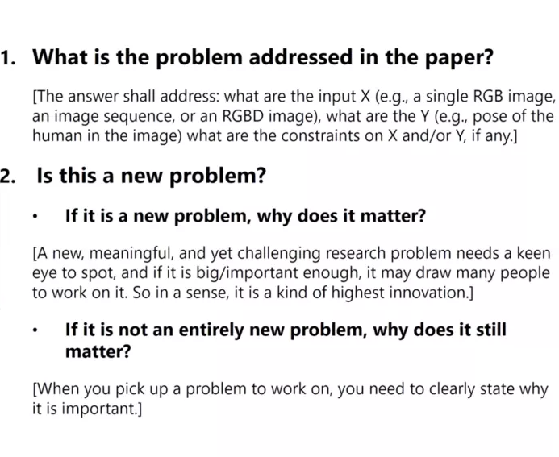
Ten questions to ask when reading a paper
https://blog.csdn.net/ProgrammerXB/article/details/107560397 华刚
Notes:
https://blog.csdn.net/ProgrammerXB/article/details/107560397 华刚

Slide 27
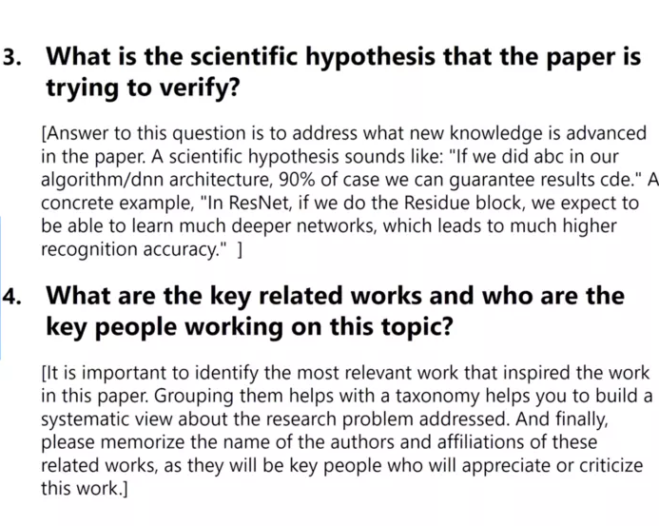
Ten questions to ask when reading a paper

Slide 28
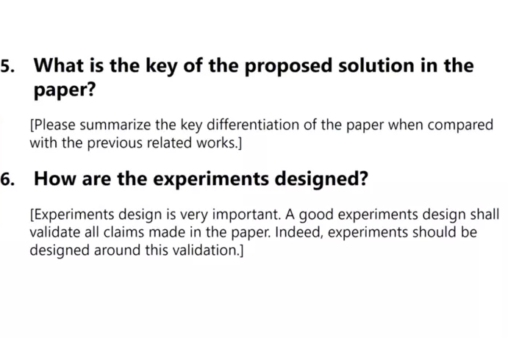
Ten questions to ask when reading a paper

Slide 29
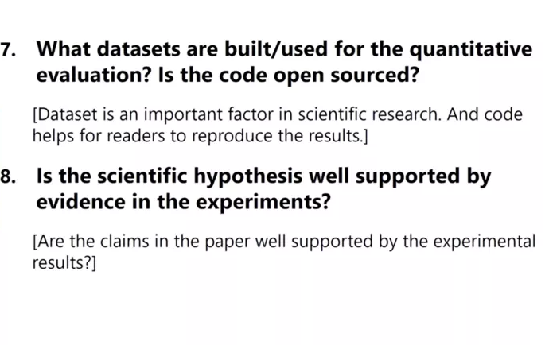
Ten questions to ask when reading a paper

Slide 30
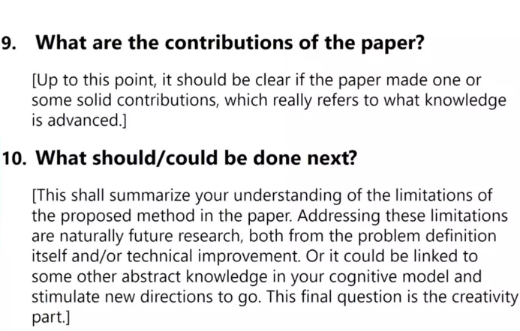
Ten questions to ask when reading a paper

Slide 31
If You’re A Presenter…
Look for background material…
  Accompanying technical report
  Follow-up journal paper
  Survey on the area
  Related Work (paper bibliography+)
  Tutorial on the area
Indexes are your friend…
  Good resources in this area
  Google

Slide 32
How to give a good research talk
Adapted from a talk by
Simon Peyton Jones
Microsoft Research
See http://research.microsoft.com/Users/simonpj/papers/giving-a-talk.htm

Slide 33
Research is communication
The greatest ideas are worthless if you keep them to yourself

Slide 34
Do it! Do it! Do it!
Good talks are a fundamental part of research excellence
Invest time
Learn skills
Practice

Slide 35

Giving a good talk
This presentation is about how to give a good research talk
What your talk is for
What to put in it (and what not to)
How to present it

Slide 36

The purpose of your talk…
..is not:
To impress your audience with your brainpower
To tell them all you know about your topic
To present all the technical details

Slide 37

The purpose of your talk…
..but is:
To give your audience an intuitive feel for an idea
To make them foam at the mouth with eagerness to (re)read the paper
To engage, excite, provoke them

Slide 38
Your audience…
The audience you would like…
Will have read the paper as many times as you
Will have read all background papers
Thoroughly understand all the relevant theory of cartesian closed endomorphic bifunctors
Are all agog to hear your interpretation of the paper
Are fresh, alert, and ready for action

Slide 39
Your actual audience…
The audience you get…
Have read the paper once
Will not have read background material
Have heard of bifunctors, but wish they hadn’t
Have just had lunch and are ready for a doze
Your mission is to
WAKE THEM UP
And make them glad they did

Slide 40

What to put in

Slide 41
What to put in
Outline (1%)
Motivation (20%)
The key idea (79%)
There is no 4

Slide 42
Outlines as Milestone Markers
Rule-of-thumb (presenting, papers, teaching…)
Tell them what you’re going to do
Do it
Tell them what you did
Variations on a theme
Remind them what you’ve done so far
Remind them what you’ve yet to do

Slide 43
Motivation
You have 2 minutes to engage your audience before they start to doze
Why should I tune into this talk?
What is the problem?
Why is it an interesting problem?
Give an example! (e.g. Battlefield monitoring)

Slide 44

The key idea
If the audience remembers only one thing from your talk, what should it be?
You must identify the key idea. “Talked about Query Optimization” is No Good.
Be specific. Don’t leave your audience to figure it out for themselves.
Be absolutely specific. Say “If you remember nothing else, remember this.”
Organize your talk around this specific goal. Ruthlessly prune material that is irrelevant to this goal.

Slide 45
Your main weapon
Examples are your main weapon
To motivate the work
To convey the basic intuition
To illustrate The Idea in action
To show extreme cases
To highlight shortcomings
When time is short, omit the general case,
not the example

Slide 46

What to leave out

Slide 47
Slides You Don’t Understand
Don’t BS! (It is far more transparent than you think)
Getting Caught is Embarassing!
It is OK not to understand some details
  You should demonstrate your effort to understand (I tried to understand X with the following example but got different results)
  You can use this as an opportunity to engage the class…
  … but don’t do this too often!

Slide 48
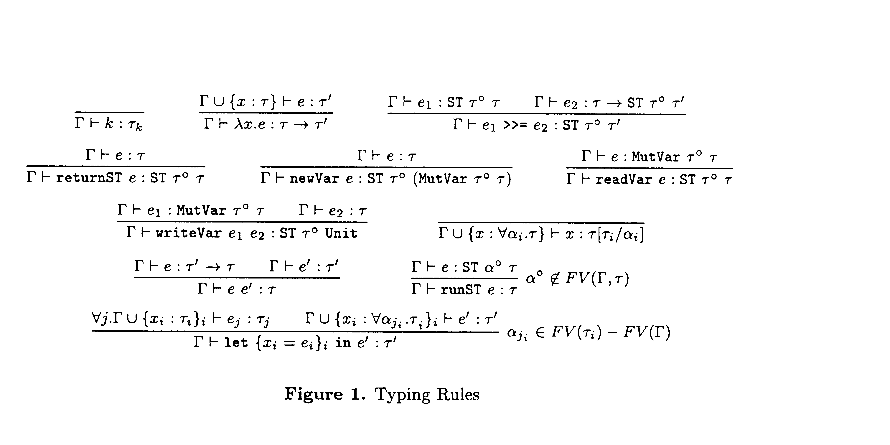
Gory details

Slide 49
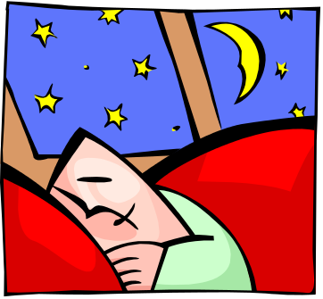
Omit gory details
Even though you spent hours understanding the details, dense clouds of notation will send your audience to sleep
Present specific aspects only
that are relevant to examples
or ideas
Note: Leaving it out doesn’t mean you don’t need to understand it!

Slide 50
Unnecessary Verbiage
Slides that have a lot of text on them put audiences to sleep. Try to avoid writing a “brain dump” on your slide. Your audience will end up reading the slide instead of listening to you (and that’s if you’re lucky) and will quickly lose interest in the talk. Worse, this practice tends to make speakers “read their slides”. YAWN!!!!. Instead…

Slide 51
Avoid Unnecessary Verbiage
Sparse slides
Key points to leave with

Slide 52
Preparing your presentation

Slide 53
2 Weeks Before Presenting…
Read the papers your group will present
Think About How to Integrate the Ideas in Various Papers
Meet with your Groupmates:
  Plan the class. E.g.
    1:40-1:55 - Introduction, Plan for Class
    1:55-2:40 – Paper #1
    2:40-3:25 – Paper #2
    3:25-3:30 – Break
    3:30-4:00 - Paper #3
    4:00-4:30 - Discussion, Integration
  Divide the Work (but plan to keep in touch!)

Slide 54
1 Week Before Presenting…
Meet with your supervisor/professor with a draft of your slides and timeline
Edit slides and timeline
Practice, practice, practice!

Slide 55
An Hour Before Presenting…
Many people experience apparently-severe pre-talk symptoms
Inability to breathe
Inability to stand up (legs give way)
Inability to operate brain

Slide 56
What to do about it
Deep breathing during previous talk
Script your first few sentences precisely
(=> no brain required)
Move around a lot, use large gestures, wave your arms, stand on chairs
Go to the bathroom first
You are not a wimp. Everyone feels this way.

Slide 57
Presenting your talk

Slide 58

How to present your talk
By far the most important thing is to
be enthusiastic

Slide 59
Enthusiasm
If you do not seem excited by your idea, why should the audience be?
It wakes ‘em up
Enthusiasm makes people dramatically more receptive
It gets you loosened up, breathing, moving around

Slide 60
Being seen, being heard
Point at the screen, not at the overhead projector
Speak to someone at the back of the room, even if you have a microphone on
Make eye contact; identify a nodder, and speak to him or her (better still, more than one)
Watch audience for questions… (I ask my share…)

Slide 61
Questions
Questions are not a problem
Questions are a golden golden golden opportunity to connect with your audience
Specifically encourage questions during your talk: pause briefly now and then, ask for questions
Be prepared to truncate your talk if you run out of time. Better to connect, and not to present all your material

Slide 62
Keep To your Timeline!
Absolutely without fail,
finish on time
Audiences get restive and essentially stop listening when your time is up. Continuing is very counter productive
Simply truncate and conclude
Do not say “would you like me to go on?” (it’s hard to say “no thanks”)

Slide 63
There is hope
You will attend 50* as many talks as you give. Watch other people’s talks intelligently, and pick up ideas for what to do and what to avoid.

Slide 64
考试
四道题
  关键词（候选集合）
  翻译文段 英文翻译中文 内容为论文摘要
  问答题：论文写作逻辑和结构相关
  应用题：英文写一个研究计划提纲
    包括题目，研究问题，研究动因、解决方案，拟采用的评估策略等。

